Slide 1
Group discussion on innovative practices: barriers and opportunities
Second Session – EU innovative solutions
Thursday, 9th May 2019
SWARM

Slide 2
What do we already know?
All kinds of challenges for WRM in the Western Balkan context – First Session
EU recommendations and legislation in water sector – First Session
Innovative practices for WRM in Program Countries – Second Session

Slide 3
Central Question
central question of the session
What should be the actions for innovation in WRM for Western Balkans?
based on our knowledge of the challenges and innovative practices

Slide 4
What would we like to achieve?
Within 80 minutes!

Slide 5
How?

Slide 6
SWOT
Strengths: characteristics that give us an advantage over others
Weaknesses: characteristics that place us at a disadvantage relative to others
Opportunities: elements in the environment that we could exploit to our advantage
Threats: elements in the environment that could cause trouble us

Slide 7
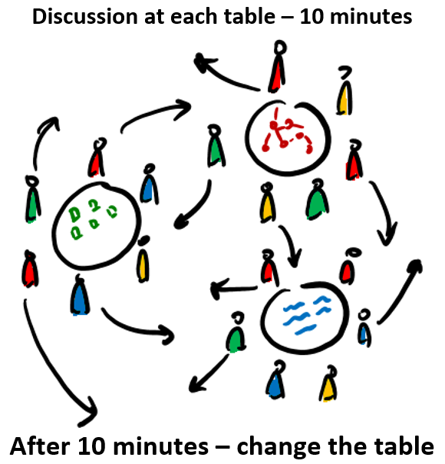
SWOT

Slide 8
Prioritization

Slide 9
Discussion

Slide 10
Let’s do it!
1. For the first round: find your initial table – look at the name list and check your name at the table
2. Participate in the discussion until the signal
3. After the signal, change to a NEW table

Slide 12
Take care of time

Slide 13
1. Country and institution
Preparing for implementation of MSc curricula & training (WP4)

Slide 14
2. Prioritize actions on how to get students interested in advance and enrolled in time in SWARM courses?
Preparing for implementation of MSc curricula & training (WP4)

Slide 15
13. How to ensure transparency of students selection for the SWARM summer schools?
Preparing for implementation of MSc curricula & training (WP4)

Slide 16
21. Who is our target audience for professional training in public sector?
Preparing for implementation of MSc curricula & training (WP4)

Slide 17
32. Who is our target audience for professional training in private sector?
Preparing for implementation of MSc curricula & training (WP4)

Slide 18
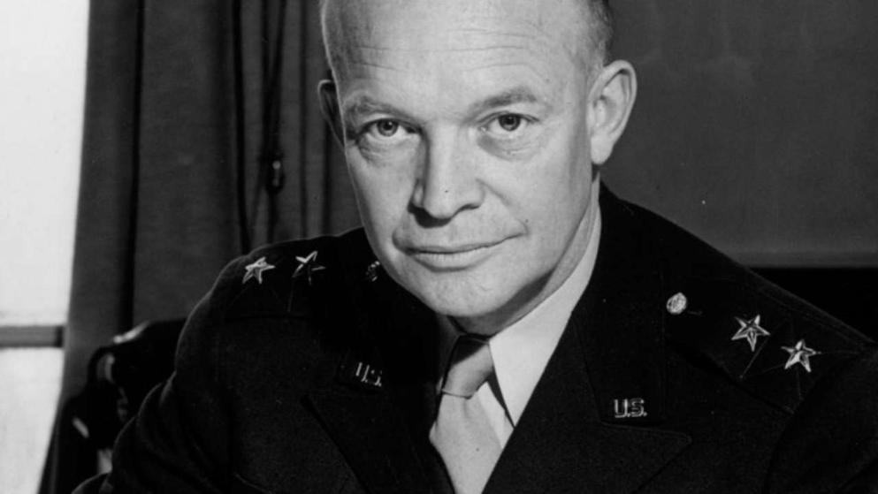

Slide 19
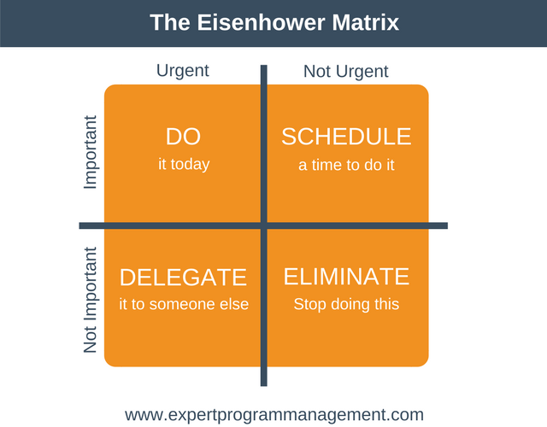

Slide 20
Prioritization
Browse to this webpage using your device
www.join.groupmap.com
2. Enter the code
431-272-079
3. Rate the findings

Slide 21
Discussion

Slide 22
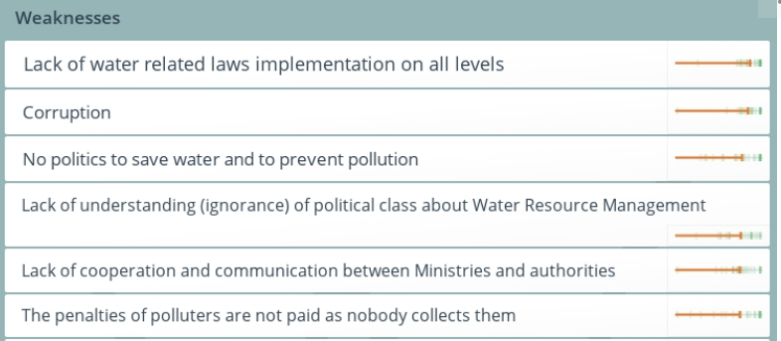
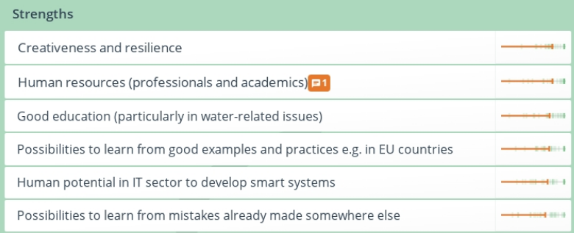
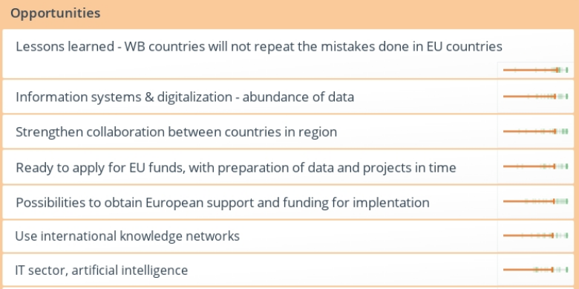
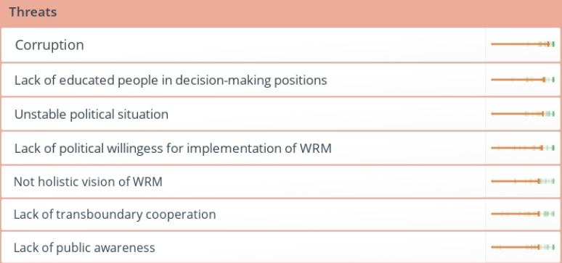

Slide 23
Conclusions

Slide 25
Water Resource Management
How we are managing (evaluating, protecting, allocating) the available water resources
Accounting, sustainability, environment
Meeting some societal / economical / environmental needs & demands

Slide 26
Innovation
Something that did not exist before
Time and space targeted
Doing something known in a different way / new application
Interdisciplinarity / multidisciplinary / transdisciplinary
Meets some societal / industrial / environmental need

